Slide 1
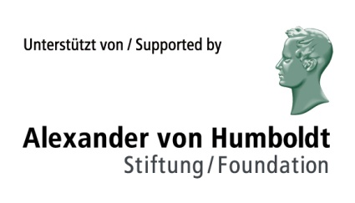
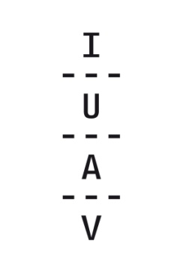
An Experimental Approach to Multimodality Investigating the Interactions between Musical and Architectural Styles in Aesthetic Perception
Martin Siefkes, University Bremen
Emanuele Arielli, IUAV Venice
Università IUAV di Venezia

Slide 2
Overview
Results of a study series on intermodal interactions between styles
Relevance for multimodality research
Style in multimodal artefacts

Slide 3
Cross-modal interactions
IUAV Venice (arts and design university)
Cognitive psychology group
Experimental aesthetics
Part of a larger project on the Experimental aesthetics of style

Slide 4
Experimental approach to style
Assumptions
Style: exists in various areas of culture and society
Style as binding link between modes in multimodal texts
Operationalization
Style perception can be measured via ratings on semantic scales
Perceptual dimensions of style can be experimentally manipulated
Current limitations
Not multimodal texts, but combinations of stimuli in different modes
BUT: Connection between modes was given via stylistic properties

Slide 5
Study I: Online study
Subjects were shown a short video (25 sec.) and asked for ratings on semantic scales.
On the next page, they were asked if they heard the music. Those who answered „No“ were excluded
4 conditions / videos
n = 626 (501 valid answers)

Slide 6
Study I
Four videos:
Baroque architecture with baroque music
Baroque architecture with modern music
Modern architecture with baroque music
Modern architecture with modern music

Slide 7
Study I
Four videos:
Baroque architecture with baroque music
Baroque architecture with modern music
Modern architecture with baroque music
Modern architecture with modern music
= intermodally congruent
= intermodally incongruent

Slide 8
Study I: Online study
Ratings of the architecture were elicited; music was not mentioned.
“Do you like the style of the buildings in the video?”
not at all – very much
“Please judge the style of the buildings on the following dimensions:”
introverted – extraverted
unbalanced – balanced
bright – dark
incoherent – coherent
grave – agitated
modest – bold
reason – feeling
complete – incomplete

Slide 9
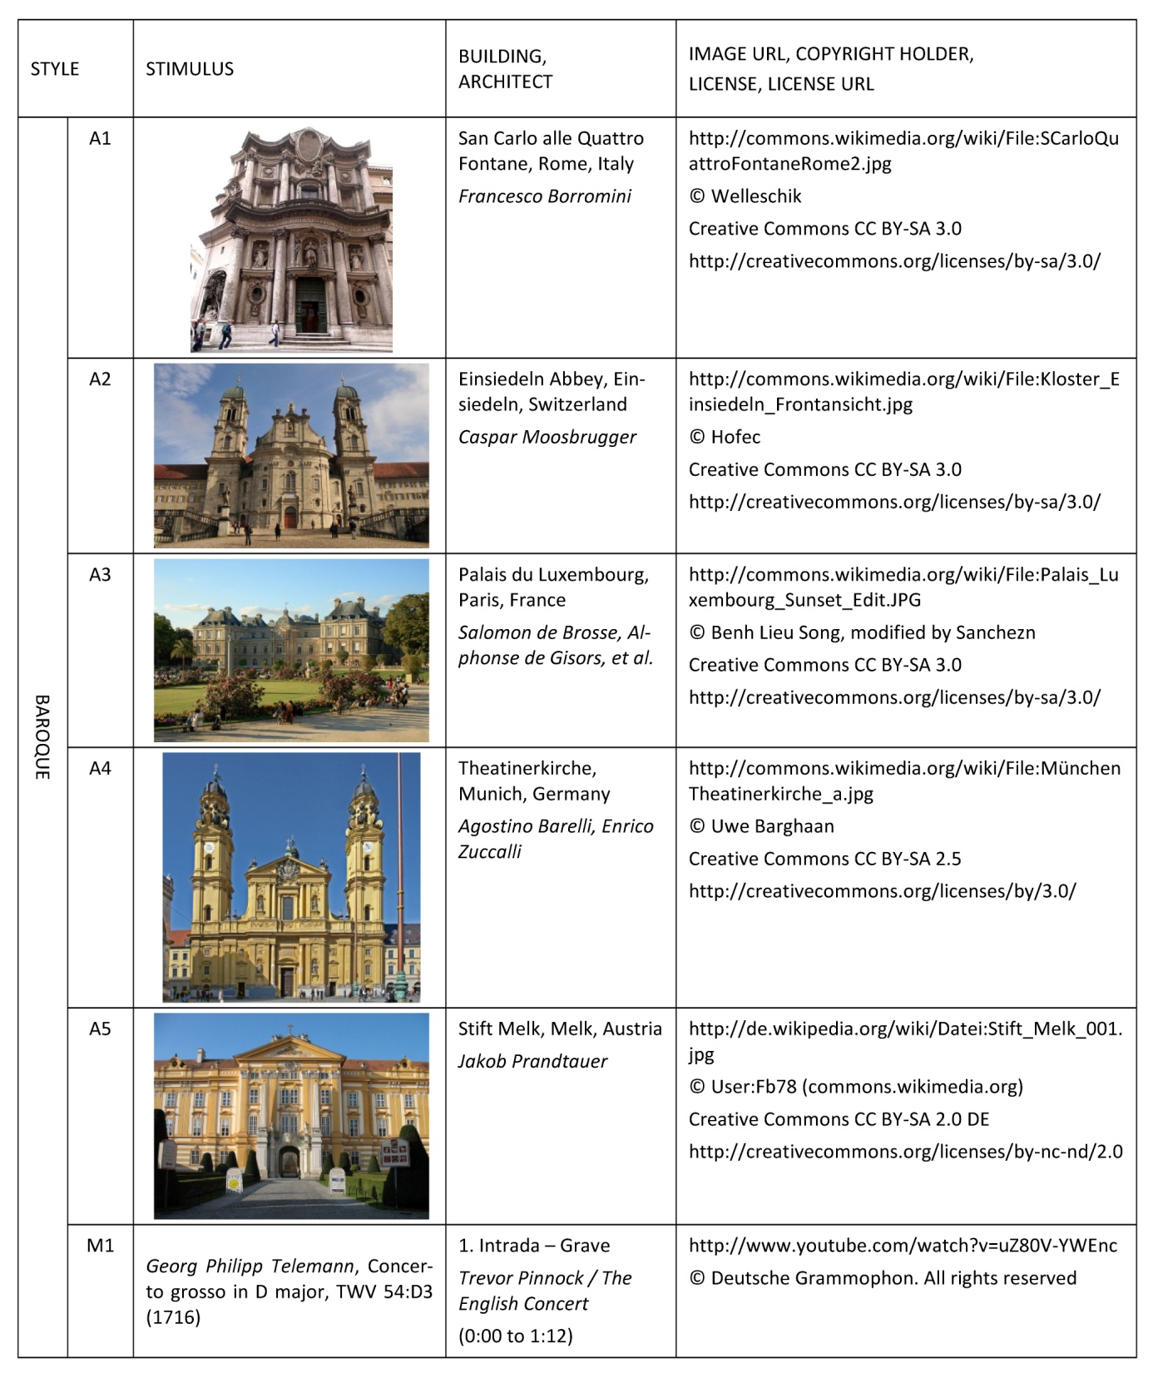

Slide 10
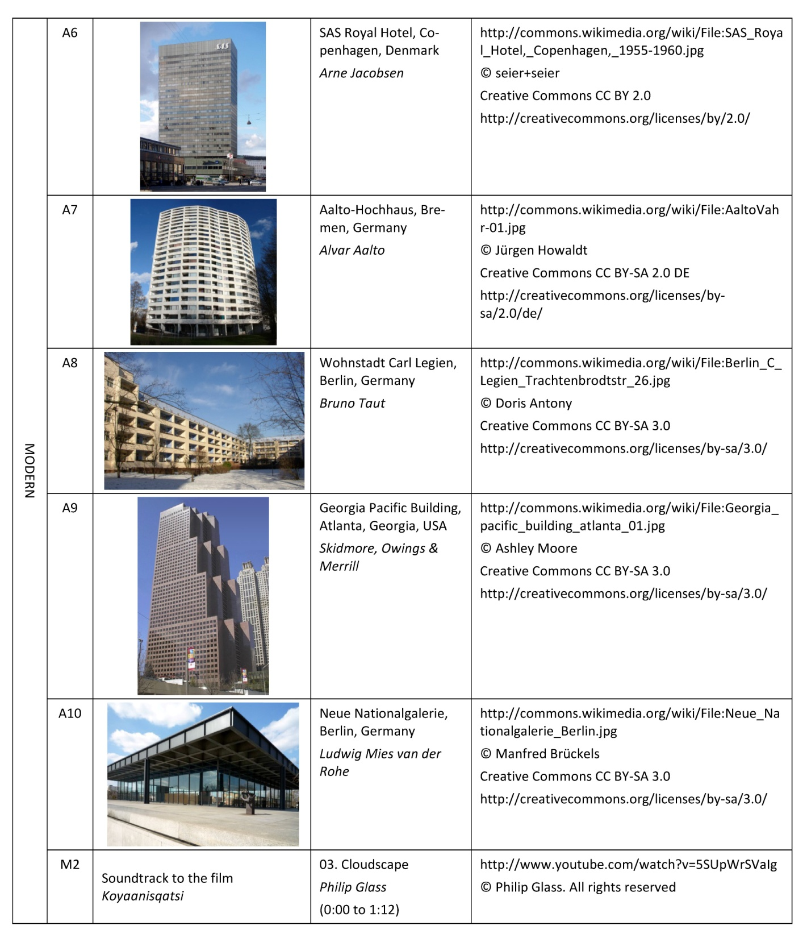

Slide 11
Baroque architecture, baroque music
intermodally congruent

Slide 12
Modern architecture, baroque music
intermodally incongruent

Slide 13
Baroque architecture, modern music
intermodally incongruent

Slide 14
Modern architecture, modern music
intermodally congruent

Slide 15
Stylistic interactions
Sliders movable by mouse (values from 0 to 101; preset to 50)
For 8 from 9 scales: effect for “architecture”
> the arch. styles were differently evaluated on all scales (except “grave – agitated”)
No main effect for “music”
> music did not influence the ratings (which were, after all, given for the architecture)
BUT: two of the nine scales showed interaction effects

Slide 16
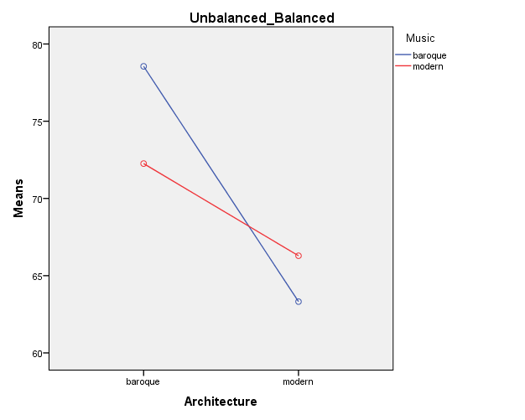
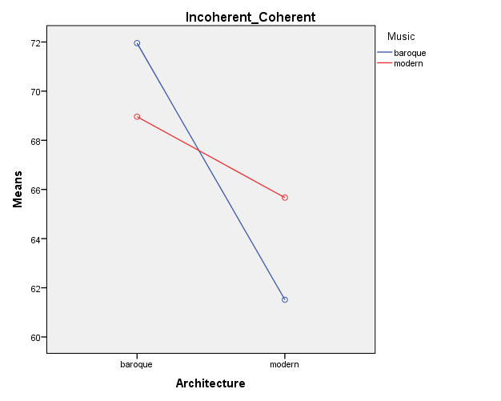
Study I: 2×2 ANOVA (architecture × music) baroque music: blue, modern music: red

Slide 17
Study II
Participants: 75 students from a design and arts faculty in Italy
Same stimuli
Same scales (with added Italian translations)
Each participant judged both architectural styles (in randomized order)
“architecture” within-subjects factor
statistical advantages (individual differences factored out) but: carry-over effects (from first to second video) possible

Slide 18
Study II
“Do you like the style of the buildings in the video?”
not at all – very much
“Please judge the style on the following dimensions:”
introverted – extraverted
unbalanced – balanced
bright – dark
incoherent – coherent
grave – agitated
modest – bold
reason – feeling
complete – incomplete

Slide 19
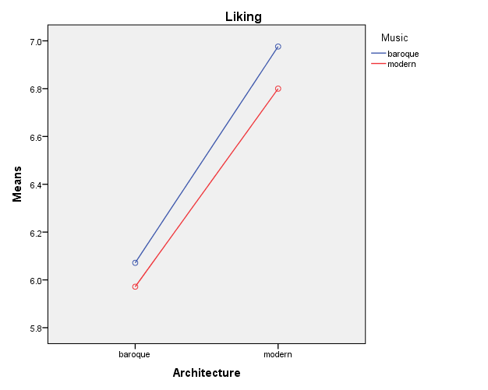
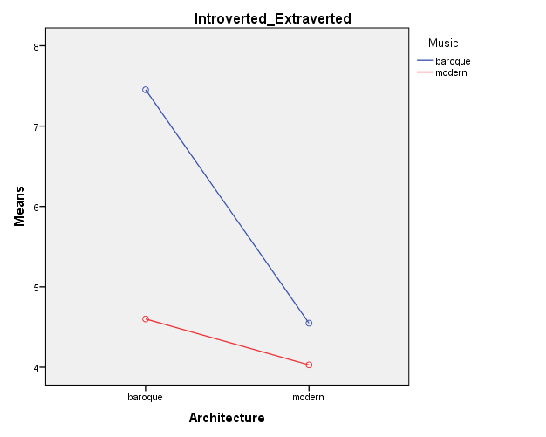
Study II: 2×2 ANOVA (architecture × music) baroque music: blue, modern music: red

Slide 20
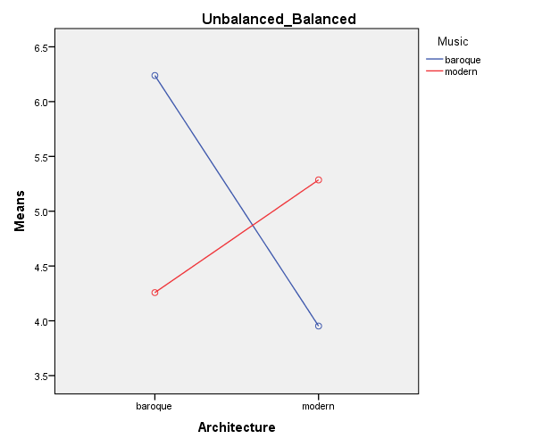
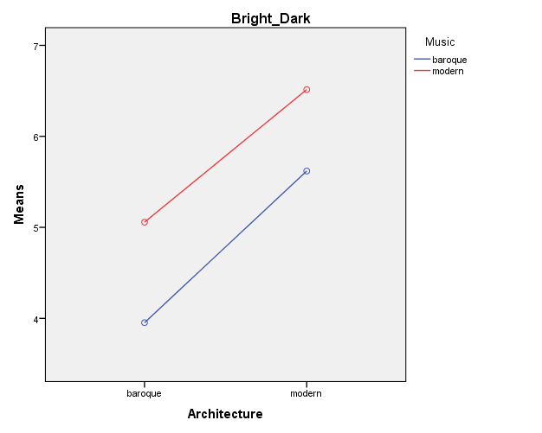
Study II: 2×2 ANOVA (architecture × music) baroque music: blue, modern music: red

Slide 21
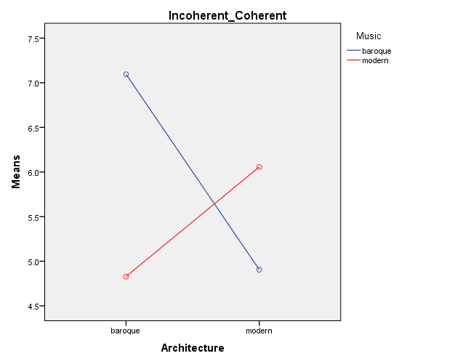
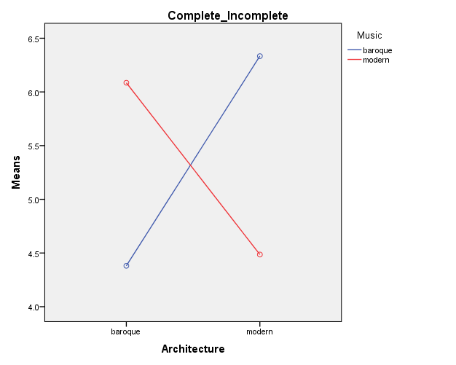
Study II: 2×2 ANOVA (architecture × music) baroque music: blue, modern music: red

Slide 22
Study I
 | Architecture | Music | Architecture × Music
aesthetic preference / liking | baroque: preferred
introverted – extraverted | baroque: extraverted
unbalanced – balanced | baroque: balanced |  | intermodally congruent: balanced
bright – dark | modern: dark
incoherent – coherent | baroque: coherent |  | Intermodally congruent: coherent
grave – agitated
modest – bold | baroque: bold
reason – feeling | baroque: feeling
complete – incomplete | modern: incomplete

Slide 23
Study II
 | Architecture | Music | Architecture × Music
aesthetic preference / liking | modern: preferred
introverted – extraverted | baroque: extraverted | baroque: extraverted | intermodally congruent: extraverted
unbalanced – balanced |  |  | intermodally congruent: balanced
bright – dark | modern: dark | modern: dark
incoherent – coherent |  |  | intermodally congruent: coherent
grave – agitated |  |  | intermodally congruent: agitated
modest – bold | baroque: bold |  | intermodally congruent: bold
reason – feeling | baroque: feeling
complete – incomplete |  |  | intermodal congruence: complete

Slide 24
Study I + II
 | Architecture | Music | Architecture × Music
aesthetic preference / liking
introverted – extraverted | baroque: extraverted
unbalanced – balanced |  |  | intermodally congruent: balanced
bright – dark | modern: dark
incoherent – coherent |  |  | intermodally congruent: coherent
grave – agitated
modest – bold | baroque: bold
reason – feeling | baroque: feeling
complete – incomplete |  |  | (?)

Slide 25
Results for style research
Some scales are reliably connected with styles
Proves the existence of relations between styles similarily categorized across modalities
Intermodal categorization terms such as “baroque” and “modern” seem not to be arbitrary

Slide 26
Results for Multimodality Research
Stylistic influences across perceptual and semiotic modalities proven
Cognitive aspects: perception and judgment of style does not function separately in mode combinations
We excepted an influence of the music for scales which are easily applied to music
> Results are ambiguous
However, some scales are unconsciously used to evaluate the relation between modalities (contrary to the task setting)
In conventional experiment setting, as well as in (uncontrolled) online study
> Probably automatic and unconscious task

Slide 27
Limitations
Results only for a carry-over task
Interactions between other layers
(form, content, discourse)

Slide 28
Location in multimodality research (tentative)
Sign processes combining modes
Multimodal
text
Non-textual
combinations

Slide 29
Textual layer model (simplified …)
Textual layers
Form
– Segmentability
– Spatial relations
– Time relations
– Combination rules
Content
– Discourse referents
– Propositions
– Inferences
Discourse
– Rhetorical structure
– Narrativity
– Intertextuality
– Context and function
Style
– Choice-related aspects
– Connect artefacts with different function / content

Slide 30
Layers in multimodal texts
Text with modalities
M₁, …, M_{n}
[Layer]
Unimodal structure
for M₁, …, M_{n}
All interactions
I(M_{i}, …, M_{j})
for i, j ∊ n; i ≠j
Holistic

Slide 31
Style in multimodal texts
Text with modalities
M₁, …, M_{n}
Style
Unimodal style
for M₁, …, M_{n}
All stylistic
interactions
I(M_{i}, …, M_{j})
for i, j ∊ n; i ≠j
Holistic
aspects of
style

Slide 32
Bibliography
Arnheim, Rudolf (1986), Style as a Gestalt Problem, in: New Essays on the Psychology of Art, 261-273.
Casakin, Hernan & Stefano Mastandrea (2009), Aesthetic emotions and the evaluation of architectural design styles. http://www.academia.edu/230845/Aesthetic_Emotions_and_the_Evaluation_of_Architectural_Styles
Höfel, Lea & Thomas Jacobsen (2007b), Electrophysiological Indices of Processing Symmetry and Aesthetics: A Result of Judgment Categorization or Judgment Report? Journal of Psychophysiology 21, 1: 9–21.
M. Siefkes (2011), How artefacts get meanings: Material culture and imagination. Kodikas/Code 34, 3-4: 357-384
M. Siefkes (2012), „The semantics of artefacts: How we give meaning to the things we produce and use“. Image 07/2012, http://www.gib.uni-tuebingen.de/image?function=fnArticle&showArticle=218
Siefkes, Martin (in prep.), Empathy in Aesthetic Judgments of Architecture. Proving Weak Aesthetic Effects with Crowdsourcing. 20 p. [submitted to International Journal of Design]
Siefkes, Martin & Emanuele Ariell (in prep.), Cross-modal Influences on Aesthetic Judgment of Style.
Siefkes, Martin & Emanuele Arielli (in prep.), Experimental Investigations of Style. Berlin/New York: Lang

