Slide 1
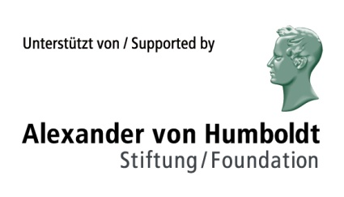
Interactions between Semiotic Modes in Multimodal Texts
Martin Siefkes, University of Bremen

Slide 2
Overview
Why investigate intermodal interactions?
Theoretical approaches
Layers of texts
Intermodal interaction types (IITs)
Some examples

Slide 3
What are intermodal relations?
In multimodal texts, different semiotic modes are used together
Modes can be considered in terms of their relations to each other
Semiotic modes can be differentiated into various layers (expression, content, intended effects, style)
All these layers can interact with layers of other modes
> Not all of this is always relevant!

Slide 4
Intermodality
Intermodal relations are a very complex problem in multimodality research
In a multimodal text, each mode contributes to overall meaning, form, and style!
Textual inferences are often based on information given in various modes (cf. Wildfeuer 2012)
There are additional textual properties that are caused by relations between modes

Slide 5
Intermodality
Intermodal relation: relations found between modes
> IIT: an “intermodal interaction type” definable by logical properties
Intermodal interaction: changes in one mode caused by the presence of another mode
> a definable change in expression, meaning, and/or style

Slide 6
Example: Intermodal deixis
Example from Gattaca (1997, A. Niccol), 00:39:40
[Jerome:] “I’m gonna finish this.”
[Vincent:] “Titan is exactly like this. All the time it’s got a cloud around it.”
Intermodal deixis (a.l, v.i)
a.l = perceptual mode: auditory semiotic mode: language
v.i = perceptual mode: visual semiotic mode: image

Slide 8
Intermodality
Intermodality or intersemiosis
Modes: sign systems ⇒ semiotics, linguistics, image studies, …
and perceptual modes ⇒ psychology, cognitive science, neuroscience

Slide 9
Basic idea
Set of intermodal interaction types (IITs)
Descriptive categories (e.g. system networks) are usually area-specific
Often-neglected part of multimodal meaning
Limited by demand for generality

Slide 10
5 modes and their interactions in a film
moving images
[v.mi]
I (v.mi, a.l)
I (v.mi, v.l)
spoken language
[a.l]
written language
[v.l]
I (a.l, v.l)
I(v.mi, a.s)
I (v.mi, a.m)
I (a.l, a.s)
I (v.l, a.m)
I (a.s, v.l)
I (a.l, a.m)
sounds
[a.s]
music
[a.m]
I (a.s, a.m)

Slide 11
Intermodality and Multimodality
For all these interactions, we can distinguish between perceptual mode (auditory, visual, …) and semiotic mode (language, images, …)
Furthermore: modes such as images comprise submodes such as color, lighting, clothing, gesture and mimics of characters
Intermodality considers aspects which cannot be found by looking at the modes separately
Thus, monomodal and multimodal analysis complement each other!

Slide 12
Three layers of text / discourse
Layer of Form / Expression
Layer of Content / Semantics
Layer of Style

Slide 13
Three layers of text / discourse
Textual layer
Form / Expression
– Segmentability
– Spatial relations
– Time relations
– Combination rules
Content / Semantics
– Discourse referents
– Propositions
– Inferences
Style
– Choice-related aspects
– Patterns not caused by function or content

Slide 14
Interactions and other structure
Text with modalities
M₁, …, M_{n}
Monomodal structure
for M₁, …, M_{n}
All interactions
I (M_{i}, …, M_{j})
for i, j ∊ n; i ≠j
Holistic structure (?)

Slide 15
Layers of two interacting modes
M₁: moving images
[v.mi]
M₁: spoken language
[a.l]
Expression:
Exp (M₁)
Expression:
Exp (M₂)
I (Exp (v.mi), Exp (a.l))
I (Exp (v.mi), Con (a.l))
Content:
Con (M₁)
Content:
Con (M₂)
I (Con (v.mi), Con (a.l))
Style:
Sty (M₁)
Style:
Sty (M₂)
I (Sty (v.mi), Sty (a.l))

Slide 16
Expression / form relations
Overlap a spatial and/or temporal overlap between expressions (= form; sign carriers) of two modes
Occlusion an overlap where the expression of one mode becomes partially occluded
Formal notation example: Occlusion (π_{i}, Exp(M₁), Exp(M₂))

Slide 17
Expression / form relations
Integration the expressions of M₁ and M₂ are integrated, i.e. cannot be separated
Parallelism a parallel organization of material in two modes: e.g. one utterance [v.l] for one panel [v.i]

Slide 18
Content relations
Similarity
Contrast
Contradiction
Background
Formal notation example: Similarity (π_{i}, Con(M₁), Con(M₂))

Slide 19
Intermodal predication
Example from Spirited Away (2001, dir. Hayao Miyazaki), 00:56:10
“You got a really good one. […] This one has dried worm salts. With water this murky, …”
Intermodal predication (a.l [v.l], v.i)
a.l = perceptual mode: auditory semiotic mode: language
v.i = perceptual mode: visual semiotic mode: image

Slide 20
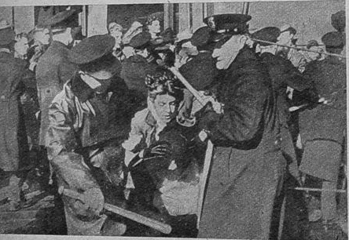
Contradiction
Intermodal contradiction (v.l, v.i)
v.i = perceptual mode: visual semiotic mode: image
v.l = perceptual mode: visual semiotic mode: language
[Subtitle:] The protest march was non-violently dissolved by the police.

Slide 21
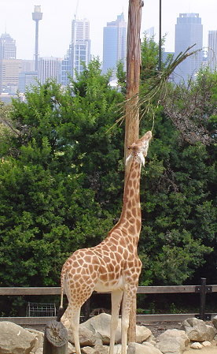
Typification
Reference modification: Typification (a.l, v.i)
v.i = perceptual mode: visual semiotic mode: image
a.l = perceptual mode: auditory semiotic mode: language
[Narrator’s voice:] “The giraffe is the largest land animal.“

Slide 22
Further content relations
Intermodal deixis
Intermodal predication
Exemplification
Disambiguation
[Reference modification:] Typification
[Reference modification:] Tokenization

Slide 23
Stylistic relations
Similarity
Varying complexity
Varying time of production
Varying (implied) producer
Parody
Formal notation example: Varying complexity (π_{i}, Sty(M₁), Sty(M₂))

Slide 24
Important points
Intermodal analysis poses highly complex problems
Important for practical results
Three distinctions:
Modes present in a text images, language, music, …
Levels of text / discourse form / expression, content, style, …
Types of interactions intermodal deixis, predication, typification, …
Methods are available in semiotics & multimodality research!

Slide 25
Research questions
Role of interactions in multimodal texts
Which list of interaction types (IITs) should we assume?
How to represent interaction types? ⇒ inclusion in a discourse representation model
When can interaction types be defined in a logical discourse model? ⇒ conditions for their presence
How can their presence be empirically determined? ⇒ annotation in corpus studies

Slide 26
Bibliography
Arnheim, Rudolf (1986), Style as a Gestalt Problem, in: New Essays on the Psychology of Art, 261-273.
Bateman, John (2011), “The decomposability of semiotic modes”, in: O’Halloran, Kay & Bradley Smith (eds.) (2011), Multimodal Studies. Exploring Issues and Domains. London: Routledge, 17-38.
Bateman, John (2014), Text and Image. A Critical Introduction to the Visual-Verbal Divide. New York: Routledge.
Calvert, Gemma, Charles Spence, & Barry Stein (2004), The Handbook of Multisensory Processes. Cambridge MA: MIT.
Elleström, Lars (ed.) (2011), Media Borders, Multimodality and Intermediality. London: Palgrave Macmillan.
Fricke, Ellen (2006), “Intermedialität, Stil und Mental Spaces: Das Visuelle als Dimension musikalischen Komponierens in Georg Nussbaumers Installationsoper ‘orpheusarchipel’”. Kodikas/Code 29(1-3), 137-155.
Fricke, Ellen (2013), “Towards a unified grammar of gesture and speech: A multimodal approach”, in: Cornelia Müller et al. (eds.), Body – Language – Communication. An International Handbook on Multimodality in Human Interaction. Berlin: de Gruyter, vol. 1, 733–754.
Liu, Yu & Kay O’Halloran (2009), “Intersemiotic texture: Analyzing cohesive devices between language and images”. Social Semiotics 19(4), 367-388.
Marsh, Emily E. & Marilyn D. White (2003), “A taxonomy of relationships between images and text”, Journal of Documentation 59(6), 647–672.
Martinec, Radan & Andrew Salway (2005), “A system for image-text relations in new (and old) media”, Visual Communication 4(3), 339–374.
Oviatt, Sharon L. (1999), “Ten myths of multimodal interaction”. Communications of the ACM 42,11: 74-81.
Siefkes, Martin (2012), “The semantics of artefacts: How we give meaning to the things we produce and use”. Image 07/2012, http://www.gib.uni-tuebingen.de/image?function=fnArticle&showArticle=218
Siefkes, Martin (forthcoming), “An Experimental Approach to Multimodality. Investigating the Interactions between Musical and Architectural Styles in Aesthetic Perception”, in: Building Bridges for Multimodal Research. Theories and Practices of Multimodal Analysis. Bern/New York: Peter Lang.
Siefkes, Martin (in review), “Frames in discourse. Connecting frame semantics and discourse analysis in an SDRT-based model”. Submitted to Modern Languages Open (MLO).
Wildfeuer, Janina (2012), “Intersemiosis in Film: Towards a New Organisation of Semiotic Resources in Multimodal Filmic Text”. Multimodal Communication 1, 3: 276-304.

