Slide 1
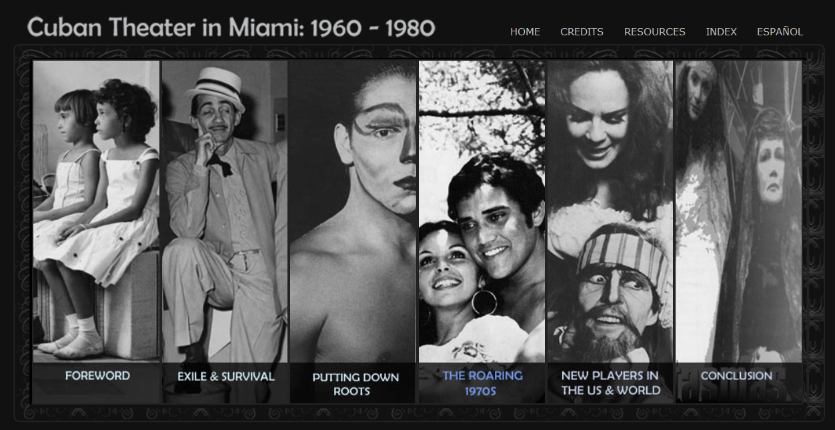
Facing Up to the Complexity:
Lessons From Online Exhibitions
Startseite, mit Logo, ohne Bild
Die Gestaltung der Bild- und Textfläche ist frei.

Slide 2
Overview
Online Exhibitions
Multimodal Complexity
Assumptions behind Annotation Schemata
Making Results Comparable

Slide 3
Online Exhibitions
More and more exhibitions take place online
Online exhibitions are a relatively young genre whose changes mirror some of the developments of the internet
Multimodal corpus analysis combines methods of corpus analysis with categories provided by multimodal semiotics
  Which patterns define online exhibitions as a multimodal genre?
  Which subtypes and changes over time can be found?
Work in progress
  Currently: development of annotation schema

Slide 4
Criteria for Judging Online Exhibitions
An award for online exhibitions:
American Book Prizes Current Exhibition Awards
  Since 2001: division Electronic Exhibitions
Complete list of submissions (c. 300 online exhibitions)
  https://rbms.info/committees/exhibition_awards/

Slide 5
Criteria for Judging Online Exhibitions
Fantastic Worlds: Science and Fiction, 1780–1910
http://library.si.edu/exhibition/fantastic-worlds
Smithsonian Libraries (Washington DC)
This exhibition didn’t win an award.

Slide 6
Criteria for Judging Online Exhibitions
Music, First and Last: Scores from the Sir Georg Solti Archive
http://hcl.harvard.edu/libraries/loebmusic/exhibitions/solti/
Eda Kuhn Loeb Music Library at Harvard University
“This online exhibition had a clean, uncluttered design, and it was easy to navigate. The ability to access complete scores is good for scholarship, while the ability to easily access audio and video enhances the experience for the visitor.”
(Exhibition awards committee)

Slide 7
Criteria for Judging Online Exhibitions
Sugar and Visual Imagination in the Atlantic World, circa 1600–1860
http://www.brown.edu/Facilities/John_Carter_Brown_Library/exhibitions/sugar/index.html
John Carter Brown Library, Brown University
“Offering something different, [this electronic exhibition] feels like an online exhibition and not a mere representation of a physical exhibit. Technically very well done, its navigation is excellent […]. Visually beautiful, the images have been chosen with great care and with a tasteful, evocative use of color. In addition, the use of ‘subtitles’ (in red italic font) adds an extra layer of curation.”
(Exhibition awards committee)

Slide 8
Overview
Folgeseiten, mit Logo
Online Exhibitions
Multimodal Complexity
Assumptions behind Annotation Schemata
Making Results Comparable

Slide 9
Different Types of Online Exhibitions
Folgeseiten, mit Logo
Conventional website:
Institut für Sexualwissenschaft (1919–1933) (Institute of Sexology)
http://www.magnus-hirschfeld.de/institut/
Curated arrangement:
Music, First and Last: Scores from the Sir Georg Solti Archive
http://hcl.harvard.edu/libraries/loebmusic/exhibitions/solti/
Individual storytelling:
Künste im Exil (Deutsche Nationalbibliothek) (Arts in Exile)
http://kuenste-im-exil.de
Virtual tour:
Rijksmuseum Amsterdam – Virtual Tour
http://www.amsterdam360.com/panos/rijksmuseum

Slide 10
Online Exhibitions as Multimodal Artefacts
Folgeseiten, mit Logo
Very high complexity
  Variety of semiotic resources: images, videos, interactive elements, virtual reality elements
  Young genre → low degree of conventionalization, quite diverse designs
  Internal and external links, 3D elements, Geobrowsers, …
  Which intermodal relations (e.g. image-text) should be considered?
  Should underlying structures (e.g. database functions) be considered?
Layers of meaning
  Exhibited artefacts already possess meanings in a culture (Siefkes 2015 on the “semantics of artefacts”)
  Curation: Curators select artefacts (often as exemplifications for larger contexts, e.g. artistic traditions) and arrange them
  Additional meanings are added through descriptions, labels etc.
  Spatial arrangement, storytelling, and framing of topics adds further meaning
But what is relevant?
  Hypotheses determine what is chosen for annotation

Slide 11
Genre-Specific Characteristics of Online Exhibitions
Folgeseiten, mit Logo
What makes an (online) exhibition an exhibition? This is by no means obvious!
Curation: selection by implicit or explicit criteria
‘Storytelling’: Arrangement intended to mirror spatial arrangements of traditional exhibitions
Storytelling / dramaturgy / narrative
Exhibition design (aesthetic qualities, typography etc.)
Interactive properties?

Slide 12
‘Spatiality’
Cuban Theater in Miami: 1960–1980
http://scholar.library.miami.edu/miamitheater
Cuban Heritage Collection at the University of Miami Libraries

Slide 13
Overview
Folgeseiten, mit Logo
Online Exhibitions
Multimodal Complexity
Assumptions behind Annotation Schemata
Making Results Comparable

Slide 14
The Unclear Status of Many Annotation Schemata
Folgeseiten, mit Logo
Annotations obviously depend on various assumptions
In practice annotation categories may be selected for different reasons. Annotation schemata can mirror
  general theoretical assumptions about multimodal texts
  assumptions about the specific genre
  hypotheses and research questions of the study
Risk of incommensurability between studies
Current status of the ‘discipline’ of multimodality
  many case studies of different genres / types
  unclear common foundations and connections between studies

Slide 15
Annotation Schema for “Exhibit Presentation”
Which modes are used for exhibit presentation?
  Images
    1 / 2 / 3 or more images
  3D simulations
    Complete / incomplete 3D simulations of exhibits
    Can the visitor rotate the object / move around the object in the room / not change the viewpoint?
  Language
    Title / Name of exhibit [Y / N]
    Verbal description [no / short / long]
    Categorical metadata [Y / N]
  Numerical information
    Numerical metadata [Y / N]
  Graphics / tables / maps
    Are there graphics / tables / maps? [Y / N]
      If yes: specific to an exhibit? [Y / N]
  Music and sound
    Is music used? (as part of the exhibit / background)
    Is sound used? (as part of the exhibit / background)
Intermodal relations
  Does the verbal description explicitly refer to one / more than one image(s)?
  Do all / some of the images of one exhibit have subtitles?
  Verbal labels for parts of images / graphics / 3D objects? [Y / N]
Layout / spatiality
  One exhibit / various exhibits per page (‘room’)?
  Is there a map showing the layout of the ‘rooms’ / exhibits in a ‘room’?
  Is a ‘hanging’ (order of the pictures) defined? [Y / N]

Slide 16
Example “Exhibit Presentation”
Folgeseiten, mit Logo
Animal, Vegetable, Mineral: Selections from the University of Delaware Library Natural History Collection
http://exhibits.lib.udel.edu/exhibits/show/animalvegetablemineral
University of Delaware Library (Newark, DE)

Slide 17
Assumptions behind Annotation Schemata for
“Exhibit Presentation”
Folgeseiten, mit Logo
Certain modes are annotated
  Are other modes assumed, but not annotated?
  If a “systems network” is given, is it intended to be complete?
Intermodality (relations between modes)
  Which model of intermodal relations is assumed?
  Which aspects are omitted?
Which categories are tested as hypotheses? Which are assumed?
  E.g. typology of exhibitions tested
Which of the annotated categories are genre-specific?
  Cf. the categories under “layout / spatiality”

Slide 18
Example “Narration & Storytelling”
Folgeseiten, mit Logo
The Greenwich Village Bookshop Door: A Portal to Bohemia, 1920–1925
http://norman.hrc.utexas.edu/bookshopdoor/home.cfm#1
Harry Ransom Center at the University of Texas at Austin

Slide 19
Annotation Schema for “Narration and Storytelling”
Which modes are used for narration & storytelling?
  Language
    Text that frames the whole exhibition [Y / N]
    Texts that introduce specific topics [Y / N]
  Images
    Header image framing the whole exhibition? [Y / N]
    Images for whole topics? [Y / N]
  Colour
    Do colours structure the exhibition? [Y / N]
  Are there exhibit previews on higher levels? (cf. glances through the door into a room)
Interaction and navigation
  1 / 2 / 3 or more navigation bars / menus?
  1 / 2 / 3 or more levels?
  Is there a preferred viewing path?
  Navigation icons / symbols (e.g. arrows)?
  Internal / external links in exhibit descriptions?
Search and categorization
  Is there a search function integrated?
  Is there a map indicating the exhibition layout?
  Can artefacts be shown by category or metadata label (e.g. author, time, content features)? [Y / N]

Slide 20
Overview
Folgeseiten, mit Logo
Online Exhibitions
Multimodal Complexity
Assumptions behind Annotation Schemata
Making Results Comparable

Slide 21
How to Create “Islands of Connected Results” (1)
Folgeseiten, mit Logo
Try to distinguish between
theoretical assumptions regarding multimodality
  Which modes / submodes are assumed / distinguished?
  Which types of intermodal relations? (cf. Siefkes 2015)
  How do you understand “mode”? (sign model / sign system / communication model)
genre-specific modelling in the annotation system
  Which modes occur in the genre?
  How do they interact?
  Genre-related functions
  Conventions of production and perception
the specific focus caused by the hypotheses
  Selection of certain areas (out of a theoretical “general annotation schema”)
  Specific perspective on the genre

Slide 22
How to Create “Islands of Connected Results” (2)
Folgeseiten, mit Logo
Your results will
test the hypotheses, but also …
be comparable to other studies based on not-too-distant theoretical assumptions
  Results can be compared if theory differences are in the open
  Your results and others may complement each other
  Theories become comparable, too! (via various aspects of their description)
help to model the genre
  Others can evaluate your decisions and build on them
  E.g. if you don’t need to annotate certain modes / intermodal relations, indicate whether they exist or not according to your assumptions
  Your model of the genre may later be compared to others

Slide 23
Related Projects at the TU Chemnitz
Folgeseiten, mit Logo
Project The Digital Museum
  Corpus analysis of online exhibitions
  Multimodal annotation
  Clustering
Project MANUACT
  BMBF-funded project that includes cooperation with museums
  http://www.manuact.org/en/
Exhibition Gesture – in the past, present, and future
  17.11.2017 – 4.03.2018, Sächsisches Industriemuseum Chemnitz
  http://www.gesten-im-museum.de/home/en/

Slide 24
Bibliography
Bateman, John (2008). Multimodality and Genre. A Foundation for the Systematic Analysis of Multimodal Documents. London: Palgrave.
Bucher, Hans-Jürgen (2011). Multimodales Verstehen oder Rezeption als Interaktion. In: Hajo Dieckmannshenke, Michael Klemm & Hartmut Stöckl (eds.). Bildlinguistik. Theorien - Methoden - Fallbeispiele. Berlin, Schmidt, 123–156.
Forceville, Charles & Urios-Aparisi, Eduardo (2009). Multimodal Metaphor. Berlin/New York: de Gruyter.
Fricke, Ellen (2006), Intermedialität, Stil und Mental Spaces: Das Visuelle als Dimension musikalischen Komponierens in Georg Nussbaumers Installationsoper ‘orpheusarchipel’. Kodikas/Code 29(1-3), 137–155.
Fricke, Ellen (2012), Grammatik multimodal: Wie Wörter und Gesten zusammenwirken. Berlin/New York: de Gruyter.
Halliday, Michael A. K. & Matthiessen, Christian M. (2004). An Introduction to Functional Grammar. London: Arnold.
Kress, Gunther & van Leeuwen, Theo (2001). Multimodal Discourse. London: Arnold.
McTavish, Lianne (2006). Visiting the Virtual Museum: Art and Experience Online. In: Janet Marstine (ed.). New Museum Theory and Practice, 226–246.
Natale, Maria T. & Sergi Fernández, Mercè L. (2012). Handbook on virtual exhibitions and virtual performances. Version 1.0. http://www.digitalmeetsculture.net/article/handbook-on-virtual-exhibitions-and-virtual-performances [retrieved 05-05-2016].
Schöps, Doris (2014). Korpusgestützte filmische Diskursanalyse am Beispiel des DEFA-Films. Zeitschrift f. Semiotik 35(3-4), 321–352.
Siefkes, Martin & Siefkes, Emanuele (2015). An Experimental Approach to Multimodality. Investigating the Interactions between Musical and Architectural Styles in Aesthetic Perception, in: Building Bridges for Multimodal Research.Bern/New York: Lang, 247–265.
Siefkes, Martin (2012). The semantics of artefacts: How we give meaning to the things we produce and use. Image. Zeitschrift für interdisziplinäre Bildwissenschaft. Image 16 (thematic issue Bildtheoretische Ansätze in der Semiotik), 07/2012
Siefkes, Martin (2015). How semiotic modes work together in multimodal texts: Towards the explanation of intermodal relations. 10Plus1 – Living Linguistics 1/2015, 113–131.
Stöckl, Hartmut (2004). Die Sprache im Bild – Das Bild in der Sprache. Zur Verknüpfung von Sprache und Bild in massenmedialen Texten. Konzepte – Theorien Analysemethoden. Berlin/New York: de Gruyter.
Wilson, Ross J. (2011). Behind the scenes of the museum website. Museum Management and Curatorship 26, 373–389.

